Slide 1
A kinetic approach to the foot orthotic management of Achilles tendinopathy and other common MSK pathologies
Using basic free-body diagrammes
Ray Anthony, MA, BSc., FRCPodS, DPodM

Slide 2
∑F a,b = - ∑F b,a
Newton's third law of motion (Motion is Newton's word for Momentum): "To every action there is always an equal and opposite reaction," or the forces of two bodies on each other are always equal and are directed in opposite directions.

Slide 3
Moment (Torque)
The Moment (Torque) of a force is a measure of its tendency to cause a body to rotate about a specific point or axis. In order for a moment to develop, the force must act upon the body in such a manner that the body would begin to twist. A moment has a direction, e.g., clockwise or counter-clockwise, or inversion of eversion, or pronation and supination and is created when a force does not have an equal and opposite force directly along its line of action. The simple equation for Moment is: M(T)=Fd
F = Newtons (I.0 lb is 4.448 N)
d = meters
Unit of measurement = Nm

Slide 4
In the biomechanics of joints, a single moment may:
Accelerate joint motion in the same direction of the moment.
Decelerate joint motion in the direction opposite the applied moment.
Stabilize a joint by counterbalancing a moment being applied across the joint in the opposite direction.

Slide 5
Vertical GRF creates External Joint Moments
If d = 18.0cm and F = 120 Newtons, Moment = 2160Ncm in a dorsiflexion direction.
If the foot is not dorsiflexing, there must be 2160Ncm of plantar flexion moment acting around the ankle joint axis = Zero Moment or Rotational Equilibrium.
18.0 cm
F
120N
Notes:
I’ll use Newton/cm instead of Newton/meter.

Slide 6
If the distance on the other side of the axis (d²)is d¹/3 (6.0cm), we know the force acting on the heel must be 3x the force acting on the forefoot or 360N to create rotational equilibrium, i.e., the foot is not moving.
d²
d¹
Fx1
120Ncm
Fx3
360Ncm
This is Newton's third law of motion (Motion is Newton's word for Momentum): "To every action there is always an equal and opposite reaction," The forces are always equal and are in opposite directions.

Slide 7
Internal Moments
If we stand the same foot on a pressure mat and discover the pressures beneath the forefoot and heel are distributed 50:50? If the foot is not dorsiflexing (rotational equilibrium), we know there must be a further plantarflexion moment of 1440Ncm acting on the foot from another origin.
6.0 cm
18.0 cm
120 N
120 N
Fx1
6 x120
= 720Ncm plantarflexionmoment
18 x120
= 2160Ncm dorsiflexion moment
Fx3

Slide 8
1440Ncm
From our understanding of functional anatomy we know the superficial posterior muscle group (calf muscles-Achilles tendon complex) provides the major internal plantarflexion moment to maintain postural stability in static stance.
6.0 cm
18.0 cm
120 N
120 N
Fx1
18 x120
= 2160Ncm dorsiflexion moment
6 x120
= 720Ncm plantarflexionmoment

Slide 9
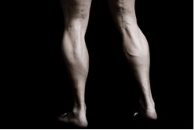
Orthotic modifications
What modulations in the magnitude and direction of GRF can we make to reduce tension in the calf muscle/Achilles tendon complex?
An increase in the magnitude of external plantarflexion moments and/or a reduction in the magnitude of external dorsiflexion moments means the Achilles tendon does not have to generate such a high magnitude of internal plantarflexion force to maintain rotational equilibrium.
Reduce the magnitude of GRF beneath the forefoot.
Increase the magnitude of GRF beneath the heel.

Slide 10
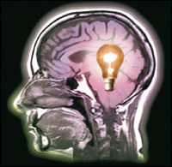
An orthosis for Achilles tendonitis might have a soft forefoot extension or a gel pad beneath the forefoot, and a hard heelcup to modulate the magnitude and temporal pattern of GRF beneath the sole of the foot.
Heel lift: Is it the lift or the increase in the magnitude of force beneath the heel that provides the beneficial therapeutic effect?
The foot has not changed position.
The foot has not been “supported.”
The foot has not be “stabilized.”
Foot posture has not changed.

Slide 11
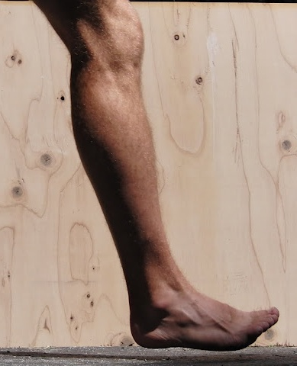
Understanding how an increase in forefoot pressure creates an increase dorsiflexion moment around the ankle, and the necessity for an increase in the plantarflexion moment from the calf muscles to effect rotational “control” during the running gait cycle gives us a clue as to why runners changing from a midstance or heel strike to a forefoot strike running style places more tensile strain through the Achilles tendon, which may make them prone to Achilles tendinopathy or calf muscle strain.

Slide 12
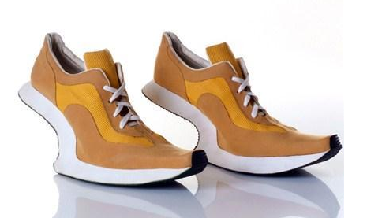
The latest running shoe for the forefoot striker!
By Kobi Levy, Israeli fashion shoe designer

Slide 13
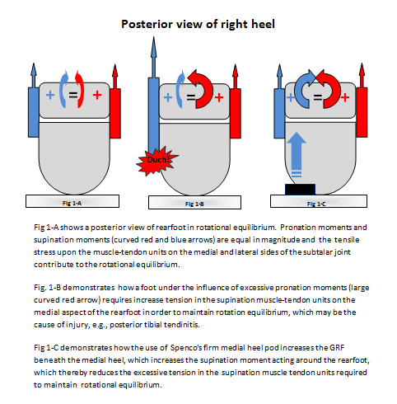
Pronation and supination moments
Achilles tendinopathy is a sagittal plane example, but the concept of GRF Modulation may be applied to modulate frontal plane moments to relieve symptoms.

Slide 14
Basic Kinetic Rx’s with no arch support
Rearfoot
1. Hard Medial /Soft Lateral:
Shift CoP medially causing an increase in the supination moment around the rearfoot. Tx for posterior tibial tendinitis, medial ankle joint capsolitis, Deltoid ligament strain, etc.
2. Soft Medial /Hard Lateral:
Shift CoP laterally causing an increase in the pronation moment around the rearfoot. Tx for peroneal tendinopathy, chronic ankle sprains, ITB syndrome at the knee, etc.
Forefoot
1. Hard Medial /Soft Lateral:
Shift CoP medially causing an increase in the dorsiflexion and inversion moment around the MTJ and First-Ray. Most common Rx to limit hallux dorsiflexion with anatomical hallux limitus/rigidus.
2. Soft Medial /Hard Lateral:
Shift CoP laterally causing an increase in the pronation moment around the MTJ. Tx for peroneal tendinopathy, chronic ankle sprains, ITB syndrome at the knee, etc.

Slide 15
Basic Kinetic Rx’s
Forefoot to Rearfoot
1. Hard Heel /Soft Forefoot
Reduce magnitude of GRF beneath forefoot and increase GRF beneath the heel. Decreases the ankle dorsiflexion moment and increases the ankle plantarflexion moment. Tx Achilles tendinopathy, calf muscle strain.
2. Soft Heel/Hard Forefoot
Increase magnitude of GRF beneath forefoot and decrease GRF beneath the heel. Increases the ankle dorsiflexion moment and decreases the ankle plantarflexion moment. Tx Extensor and Tibialis Anterior tendinopathy.

Slide 16
Overuse injuries may occur when healthy tissue is stressed in an abnormal way; when unhealthy tissue is stressed in a normal way, or when unhealthy tissue is stressed in an abnormal way.
Each tissue type has a zone of optimal stress – ZOOS.

Slide 17
Conclusions
Abnormal tensile and compressive forces cause tissue damage.
Excessive forces may occur WITHOUT MOTION.
Foot orthoses produce small, unpredictable and subjective kinematic changes.
Research suggest that orthotic devices have a greater kinetic rather than kinematic effect.
Kinematic to kinetic paradigm shift is taking place; many would say has already taken place.
Think force instead of motion.
Aim of foot orthotic device is to return tissues to ZOOS.
Discover and work the Tissue Stress Paradigm and use orthotic Rxs to reduce stress in the injured tissues.
It doesn’t matter what the foot looks like on the orthosis!

Slide 18
From: The myths of foot orthoses… A guest article by Ian Griffiths, The Sport Physio @ Wordpress.com
“The skilled clinician is capable of identifying the dysfunctional tissue (and the severity of injury to it); they understand the biomechanical function of the tissue during given activities; and they comprehend the manner in which each of the 3 orthoses design variables interact with one another, and ultimately their kinetic influence on the foot.”

Slide 19
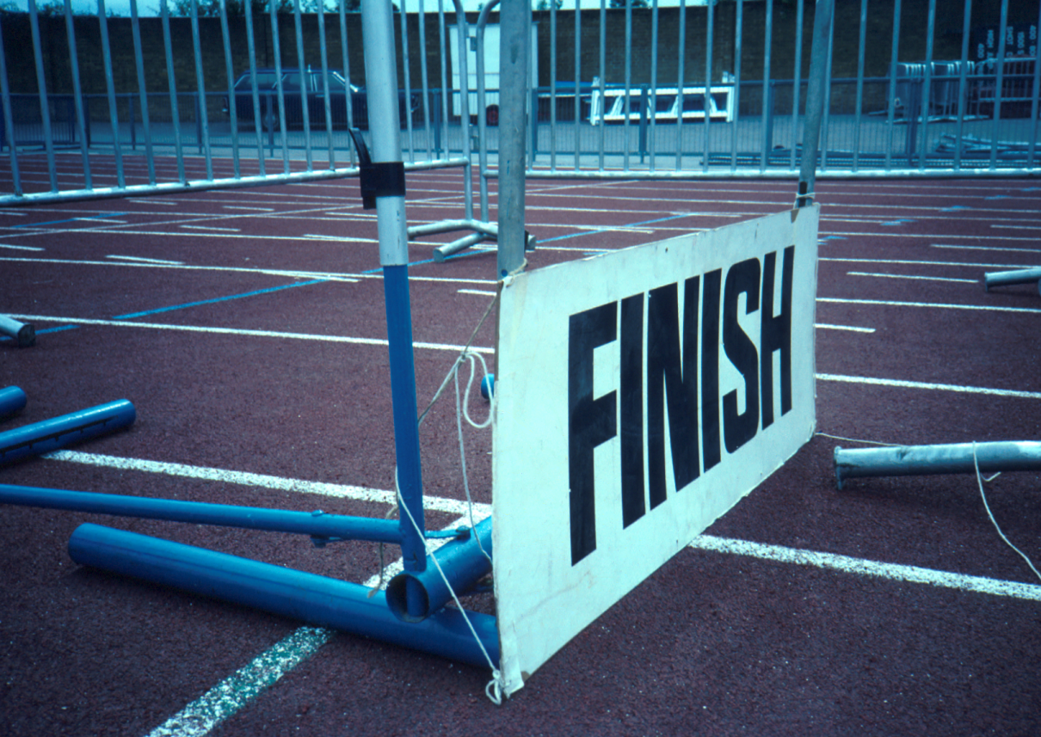
Thank you

