Slide 1
A Kinetic Approach to Foot Orthotic Therapy
Raymond J. Anthony, FCPodS, DPodM

Slide 2
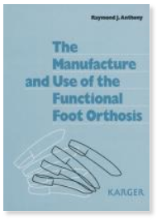
Raymond J. Anthony, FCPodS, DPodM
Author: The Manufacture & Use of the Functional Foot Orthosis, Karger, 1991.
Prior owner RX Laboratories, UK for over 20-years.

Slide 3
Paradigm Shift in Foot Orthotic Therapy
According to philosopher Thomas Kuhn in his influential book The Structure of Scientific Revolutions (1962), a paradigm shift, or revolutionary science, is a change in the basic assumptions within the ruling theory of science.
Kuhn said: "A paradigm is what members of a scientific community, and they alone, share" (The Essential Tension, 1977).

Slide 4
How foot orthotic devices produce their beneficial therapeutic effects

Slide 5
KINEMATIC PARADIGM
Kinematics: the branch of classical mechanics which describes the motions of points, bodies (objects) and systems of bodies (groups of objects) without consideration of the cause of the motions.
KINETIC PARADIGM
Kinetics: The branch of classical mechanics that deals with the actions of forces in producing or changing the motion of masses.

Slide 6
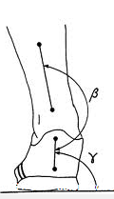
Foot orthoses do alter the kinematics of the foot and lower-limb
Bates BT, Osternig LR, Mason B, James LS: Foot orthotic devices to modify selected aspects of lower extremity mechanics. Am J Sp Med, 7:328–31, 1979.
Smith LS, Clarke TE, Hamill CL, Santopietro F: The effects of soft and semi-rigid orthoses upon rearfoot movement in running. JAPMA, 76:227–232, 1986.
Eng JJ, Pierrynowski MR: The effect of soft foot orthotics on three-dimensional lower-limb kinematics during walking and running. Phys Therapy, 74:836–844, 1994.
MacLean CL, Hamill J: Short and long-term influence of a custom foot orthotic intervention on lower extremity dynamics in injured runners. Annual ISB Meeting, Cleveland, September 2005.
Decrease maximum rearfoot eversion angle and velocity

Slide 7
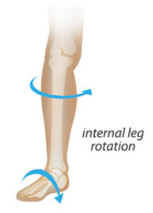
Foot orthoses do alter the kinematics of the foot and lower-limb
Williams DS, McClay-Davis I, Baitch SP: Effect of inverted orthoses on lower extremity mechanics in runners. Med Sci Sports Exerc 35:2060–2068, 2003.
Eng JJ, Pierrynowski MR: The effect of soft foot orthotics on three-dimensional lower-limb kinematics during walking and running. Phys Therapy, 74:836–844, 1994.
Nawoczenski DA, Cook TM, Saltzman CL: The effect of foot orthotics on three-dimensional kinematics of the leg and rearfoot during running. J Ortho Sp Phys Ther, 21:317–327, 1995.
Stackhouse CL, Davis IM, Hamill J: Orthotic intervention in forefoot and rearfoot strike running patterns. Clin Biomech, 19:64–70, 2004.
Decrease maximum internal tibial rotation

Slide 8
Foot orthoses do alter the kinematics of the foot and lower-limb
MacLean CL, Hamill J: Short and long-term influence of a custom foot orthotic intervention on lower extremity dynamics in injured runners. Annual ISB Meeting, Cleveland, September 2005.
Williams DS, McClay-Davis I, Baitch SP: Effect of inverted orthoses on lower extremity mechanics in runners. Med Sci Sports Exerc 35:2060–2068, 2003.
Eng JJ, Pierrynowski MR: The effect of soft foot orthotics on three-dimensional lower-limb kinematics during walking and running. Phys Therapy, 74:836–844, 1994.
Nawoczenski DA, Cook TM, Saltzman CL: The effect of foot orthotics on three-dimensional kinematics of the leg and rearfoot during running. J Ortho Sp Phys Ther, 21:317–327, 1995.
Stackhouse CL, Davis IM, Hamill J: Orthotic intervention in forefoot and rearfoot strike running patterns. Clin Biomech, 19:64–70, 2004.
Decrease maximum ankle dorsiflexion angle
Decrease knee adduction

Slide 9
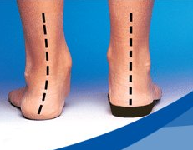
Predictability of the kinematic effect
It is virtually impossible to accurately predict how a particular foot will kinematically respond to a particular foot orthotic device.
When a pronated foot with an everted heel is placed upon an orthotic device with a rigid 4° medial rearfoot post will the heel invert 4°? Some feet will not change position. In some feet the heel may invert a degree or two. In other feet, the heel may markedly invert. The positional change is dependent the joint ranges of motion, the orientation of the joint axes, and the magnitude and direction of the GRF acting around the joint axes.
Is this dramatic change in foot posture common?

Slide 10
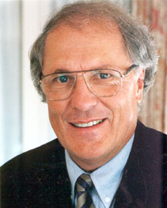
Extent of kinematic changes
“Orthotic effects on eversion and tibial rotations were found to be small and unsystematic over all subjects. Orthoses may have only small kinematic effects on the calcaneus and tibia.”
Nigg, et al: Effect of foot orthoses on skeletal motion during running, Clin Biomech (Bristol, Avon), 2000 Jan;15(1):54-64
Dr. Benno Nigg
Notes:
Objective: To quantify the effects of medial foot orthoses on skeletal movements of the calcaneus and tibia during the stance phase of running. 5 healthy male subjects. Cortical bone pins in the feet and surface markers on the shoe Three dimensional tibio-calcaneal rotations were determined using a joint coordination system Eversion – skeletal and shoe, and tibial rotation were calculated.

Slide 11
“The average group changes resulting from the studied inserts in total shoe eversion, total foot eversion, and total internal tibial rotation were typically smaller than 1 degree when compared with the no-insert condition and were statistically not significant”.
Nigg, et al: Effect of shoe insert construction on foot and leg movement. Sci Sports Med Exerc. 1998 Apr;30(4):550-5).
“Orthotic effects on eversion and tibial rotations were found to be small and unsystematic over all subjects.
Orthoses may have only small kinematic effects on the calcaneus and tibia.”
Nigg, et al: Effect of foot orthoses on skeletal motion during running, Clin Biomech (Bristol, Avon), 2000 Jan;15(1):54-64
Notes:
PURPOSE:
The purpose of this study was to quantify changes in foot eversion and tibial rotation during running resulting from systematic changes of material composition of five shoe inserts of the same shape.
METHODS:
Tests were performed with 12 subjects. The inserts had a bilayer design using two different materials at the top and bottom of the insert. The functional kinematic variables examined in this study were the foot-leg in-eversion angle, and the leg-foot tibial rotation. Additionally, the subject characteristics of arch height, relative arch deformation, and active range of motion were quantified. The statistical analysis used was a two way repeated measures MANOVA (within trials and inserts).
RESULTS:
The average group changes resulting from the studied inserts in total shoe eversion, total foot eversion, and total internal tibial rotation were typically smaller than 1 degree when compared with the no-insert condition and were statistically not significant. The measured ranges of total foot eversion for all subjects were smallest for the softest and about twice as large for the hardest insert construction. Thus, the soft insert construction was more restrictive, forcing all feet into a similar movement pattern, whereas the harder combinations allowed for more individual variation of foot and leg movement and did not force the foot into a preset movement pattern. The individual results showed substantial differences between subjects and a trend: Subjects who generally showed a reduction of tibial rotation with all tested inserts typically had a flexible foot. However, subjects who generally showed an increase of tibial rotation typically had a stiff foot.

Slide 12
The concept of arch support
“Simple linear regression analyses showed that arch height does not influence either maximal eversion movement or maximal internal leg rotation during running stance.”
Nigg BM, Cole GK, Nachbauer,W: Effects of arch height of the foot on angular motion of the lower extremities in running, J. Biomehanics, 1993, Aug;26(8):909-16.
Dr. Benno Nigg

Slide 13
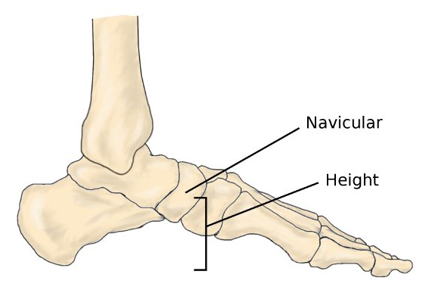
Arch Height
“Arch height is a poor predictor of how the foot functions and how it will react to a change in the magnitude and direction of vertical GRF.”
Cashmere T, Smith R, Hunt R: Medial longitudinal arch of the foot: stationary versus walking measures, Foot Ankle Int. 1999 Feb:20(2):112-8.
Why quantify the arch height and make orthoses to try to effect a change in the position of the
arch height?
Notes:
The characteristics of the medial longitudinal arch (MLA) of the right foot in 19 healthy men while sitting/partial bodyweight, standing/full bodyweight, and during the stance phase of walking. Three measurements were selected as representative of the MLA, including: height of the arch, length of the arch, and supranavicular angle. Mean values were calculated in three dimensions for each measure in the sitting and standing conditions and for the minimum value of each measure in the walking condition. Patterns measured during walking had high association (r = 0.999) and could be related to phases of stance. In the stationary conditions, the MLA varied significantly (P<0.001). No significant relationship of arch height, arch length, or supranavicular angle was found between sitting and standing or between stationary and walking conditions. It was concluded that none of the static variables could be used to predict others and that static measures of the MLA do not predict the dynamic motion of the MLA. The MLA may not be a reasonable indicator of behavior or motion of the foot.
More recent studies have shown that static longitudinal arch angle and arch height were predictive of the dynamic foot at midstance:
J Am Podiatr Med Assoc. 2005 Mar-Apr;95(2):114-20.
Use of the longitudinal arch angle to predict dynamic foot posture in walking.
McPoil TG, Cornwall MW.
J Am Podiatr Med Assoc. 2007 Mar-Apr;97(2):115-20.
The ability to predict dynamic foot posture from static measurements.
Franettovich MM, McPoil TG, Russell T, Skardoon G, Vicenzino B.

Slide 14
If foot orthoses do NOT provide significant “motion control”, how do they work to provide beneficial therapeutic effects?

Slide 15
“You have to know the past to understand the present.”
-- Carl Sagan, 1934 – 1996
Astronomer, writer, and scientist.

Slide 16
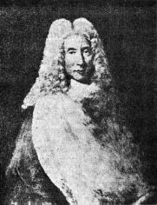
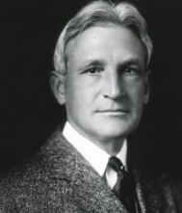
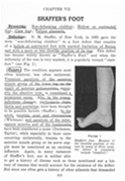
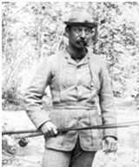
Kinematic foot orthotic therapy
Nicolas Andry de Bois-Regard (1741) | “If the feet incline too much to one side, you must give the child shoes that are higher on that side, both in the sole and heel, which will make him incline to the opposite side.”
Dr. Royal Whitman (1889) | Rigid steel plates with high medial and lateral flanges and no heelcup manufactured over a supinated cast to treat “Weak Foot.” Whitman Foot Brace to reduce excessive foot Pronation.
Dr. N.M. Shaffer (1897) | Described a high arch foot with claw toes – “Shaffer’s Foot” along with a high arch orthosis with a heelcup, which became known as a “Schaffer Plate.” Standard shell shape still offered by commercial labs today.

Slide 17
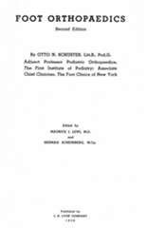
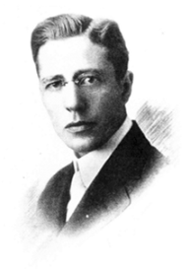
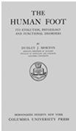
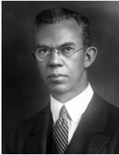
Dr. P.W. Roberts (1912) | Modified the Whitman plate with lower flanges plus an inverted heelcup. Caused irritation to plantar aspect of the foot. Inverted Orthotic (viz. Blake Inverted)
Dr. Otto Schuster (1927) | Wrote Textbook Foot Orthopedics. Combined the ideas of Whitman and Roberts to create the Whitman- Roberts Brace, more easily tolerated by the wearer.
Dr. Dudley Morton (1935) | In his 1935 publication The Human Foot, It’s Evolution, Physiology and Functional Disorders (1935) describe a short and hypermobile 1st metatarsal segment as a cause of excessive foot pronation. Atavistic Theory. Load Deformation of the 1st Ray.

Slide 18
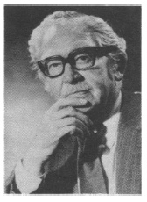
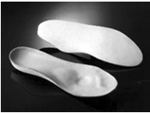
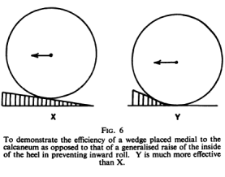
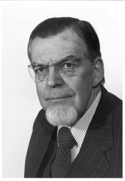
William Sayle-Creer (1938) | “By wedging the inner border of the heel the tibials are relieved. By wedging the outer side of the sole, the strain on the peroneus longus is removed. Clinical practice shows that the degree of wedging must be determined for each individual case.” Tissue Stress Paradigm.
Dr. Benjamin Levy (1950) | Rubber-butter arch support insoles with a metatarsal dome and toe crest to reduce forefoot pressure – “Levy Mould.” Total Contact Insole.
Schreiber & Weinerman (1953) | Described a method to quantify the frontal plane FF-RF position and advised supporting varus and valgus forefoot positions to prevent retrograde compensation at the rearfoot.
Dr. G.K. Rose (1958) | Described how to take a negative cast of the foot with the hallux dorsiflexed to raise the arch, and how varus heel wedges should be manufactured to be most effective

Slide 19
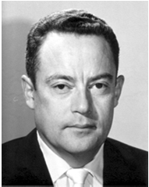
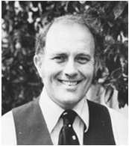
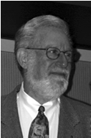
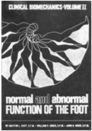
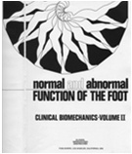
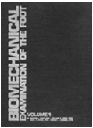
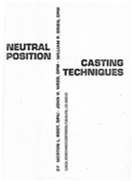
Dr. M.L. Root (1922-2002) Gradated CCPM in 1952. Established world’s first Department of Podiatric Biomechanics at CCPM in 1966. Bulk of work from 1958 – 1977, | Subtalar Joint (STJ )Neutral Position. Foot typing by morphology. Described 8 Biophysical Criteria for Normalcy. “Function follows form.” Neutral Position Suspension Casting. Root Functional Orthosis using thermoplastics: NP cast Forefoot deformity balanced Medial addition to lower the arch Lateral expansion Heelcup orientated inverted for PCRFV RF “Post” with motion to allow for calcaneal eversion from initial contact to foot flat. Root M.L.: How was the Root functional foot orthotic developed? Perspectives in Podiatry, Fall 1981

Slide 20
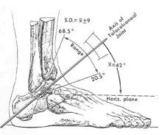
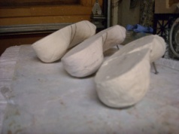
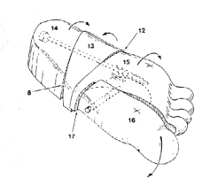
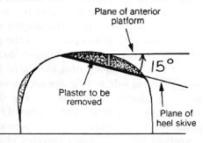
Additions to the Root Orthotic Prescription Paradigm
Phillips (1985) | Clinical method to determine the STJ axis in 3-planes. Pronation skive in RF posts to suit the sagittal plane pitch of the axis. Modified Root. | Phillips, Cristeck ,& Phillips: Clinical measurement of the axis of the subtalar joint, JAPMA, 75: No.3 (1985).
Blake (1986) | Large FF cast balances to invert the heelcup to increase the pronation control. Blake Inverted. | Blake RL: Inverted functional orthosis, JAPMA, 76: No.5, 1986.
Lundeen (1988) | Divide the cast into forefoot , midfoot, rearfoot, and first ray segments and rotate segments into varying positions. Triaxial Posting. (Also introduced the Modified Medial Addition) | Lundeen, R0: Polysectional Triaxial Posting - A New Process for Incorporating Correction in Foot Orthoses, JAPMA, Vol. 78, No. 2, February 1988.
Kirby (1992) | For patients with medially deviated STJ axes causing marked pronated feet Kirby Skive. KINETIC. | Kirby, K.A.: The Medial Heel Skive Technique, JAPMA, Vol. 82, No. 4, April 1992.
Notes:
The reason for the additions was the failure of the classic Root orthosis to maintain the foot in a less pronated (neutral ) position.
Philips paper: Green & Carol: Planal Dominance JAPA, Vol. 74, No. 2, 1984

Slide 21
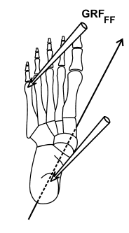
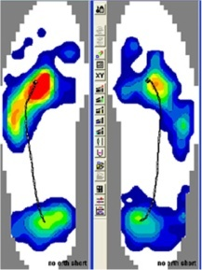
Paradigm shift in the 1990s
Encouraged by the rapid development of foot pressure mapping technology, the Root kinematic paradigm is challenged.
Kinetic approach to understanding the effects of foot orthotic therapy begins to emerge.

Slide 22
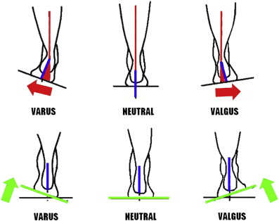
Root’s “Biophysical Criteria for Normalcy” is all but dismissed as an invalid model
Platonian ideal and contrary to widely used reference ranges to define “normal.”
“Root’s definition of an ideal foot is based on an invalid theoretical concept . . . the criteria for the ideal foot does not fall in the middle of a normal bell-shaped distribution of a population sample.”
Astrom & Arvidson: Alignment and Joint Motion in the Normal Foot, J Orthop Sports Phys Ther, 22: 216, 1995.
Notes:
The published literature throughout the 1990s is dominated by McPoil and Cornwalls deliberate, I THINK, AND SYSTEMATIC DISMANTLING OF THE Root Paradigm.

Slide 23
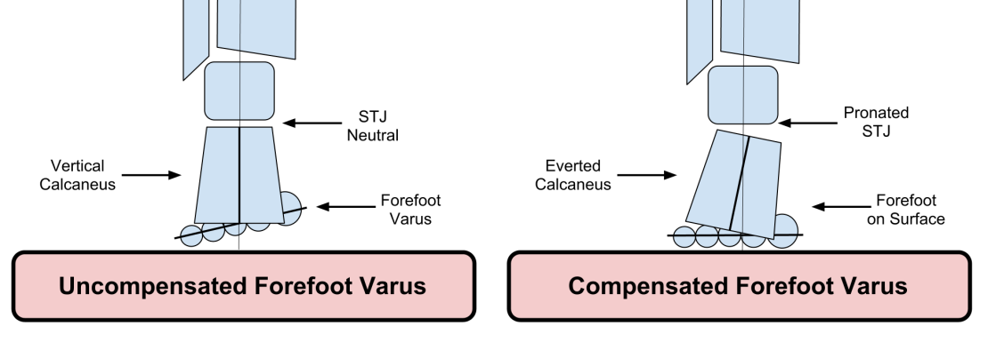
Research in the 90’s revealed that function does not always follow static form:
Hamill, Bates, Knutzen et al: Relationship between selected static and dynamic lower extremity measurements, Clin Biomech 4:217, 1989.
Knutzen & Price: Lower extremity static and dynamic relationships with rearfoot motion in gait, JAPMA 84:171, 1994.
McPoil & Cornwall: The relationship between static lower extremity measurements and rearfoot motion during walking, J Orthop Sports Phys Ther 24:309, 1996.
Kinematic foot function cannot be predicted from static Rootian foot types, e.g., a FF Varus doesn’t always cause calcaneal eversion.
Notes:
The published literature throughout the 1990s is dominated by McPoil and Cornwalls deliberate I THINK AND SYSTEMATIC DISMANTLING OF THE Root Paradigmthink)

Slide 24
The validity of Root’s STJ NP is questioned -
no anatomical basis.
“Lull” position in the bottom of the arc of STJ motion (Root)
Position of the STJ when the TN joint is congruent (Langer/Wernick).
Maximum articular contact of the anterior and/or posterior facets of the STJ (Kirby?).
Chen, et. al: Assessment of subtalar joint neutral position: a cadeveric study, Chin Med J (Engl.), Apr 20; 121(8):735-9 (2008). When the anterior and posterior facets of the STJ are in max articular contact the foot was 10° abducted, 20° degrees dorsiflexed, and 10 ° everted.
Notes:
The published literature throughout the 1990s is dominated by McPoil and Cornwalls deliberate I THINK AND SYSTEMATIC DISMANTLING OF THE Root Paradigmthink)
Chen: 12 frozen cadavers. Pressure sensitive film in ant and post facets. Axial load of 600 N. Feet positioned into max articular contacts of both facets.

Slide 25
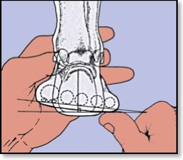
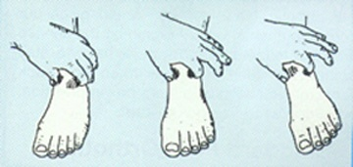
The ability of clinicians to place the STJ in neutral position is extremely variable
Pierrynowski, Smith & Mlynarczyk: Proficiency of foot care specialists to place the rearfoot at subtalar joint neutral, JAPMA 86: 217, 1996.
Smith-Oricchio & Harris: Interrater reliability of subtalar joint neutral, calcaneal inversion and eversion, J. Orthop Sports Phys Ther, 12: 10, 1990.
Foot Neutral using TN congruency and MTJ fully pronated
Notes:
The published literature throughout the 1990s is dominated by McPoil and Cornwalls deliberate I THINK AND SYSTEMATIC DISMANTLING OF THE Root Paradigmthink)
Chen: 12 frozen cadavers. Pressure sensitive film in ant and post facets. Axial load of 600 N. Feet positioned into max articular contacts of both facets.

Slide 26
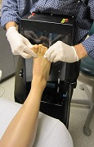
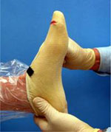
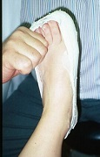
Neutral Position Casting
Despite the concerns over the validity of STJ NP, many respected practitioners (including some detractors of the Root paradigm) still cast or scan the foot with the foot held in NP – most commonly talo-navicular congruency and the forefoot fully pronated to end range.
“Closed Packed Joint Position Casting” instead of “Neutral Position Casting”

Slide 27
In the mid-90s, Root’s placement of STJ NP in the gait cycle is challenged.
McPoil & Cornwall: The relationship between subtalar joint neutral position and rearfoot motion during walking, Foot& Ankle, 15:141, 1994.
Pierrynowski & Smith: Rearfoot inversion/eversion during gait relative to the subtalar joint neutral position, Foot & Ankle, 17:406, 1995.
Notes:
The published literature throughout the 1990s is dominated by McPoil and Cornwalls deliberate I THINK AND SYSTEMATIC DISMANTLING OF THE Root Paradigmthink)

Slide 28
Taking stock
There is no best or ideal or normal or correct foot posture for everyone.
Although a number of authors suggest that foot orthotic devices do effect kinematic changes, research indicates the changes are unpredictable, subject specific, small (1-2 degrees) and are often contrary to expectation.
Orthoses change osseous segmental alignment to a small degrees in some patients some of the time.
They do change rearfoot kinematics:
Bates et al, 1979; Smith et al, 1986; Novick and Kelly, 1990; McCulloch et al, 1993; Stell & Buckley, 1998; Leung et al, 1998;Genova & Gross, 2000; Nester et al, 2001; Woodburn et al,2003.
They do not change rearfoot kinematics:
Rodgers & Leveau, 1982; Blake and Ferguson, 1993; Brown et al, 1995; Nawoczenski et al., 1995; Nigg et al. 1997; Butler et al, 2003; Stackhouse et al, 2003; Williams et al, 2003

Slide 29
Taking stock
Arch height has little influence on either maximal eversion movement or maximal internal leg rotation during gait. Achieving a change in arch height with foot orthoses is therefore likely to be pathomechanically insignificant.
Orthoses have been shown to reduce pain and improve the symptoms of musculoskeletal pathology in some patients some of the time; so if they have very little kinematic effect. . .
. . .HOW DO THEY WORK?

Slide 30
Williams DS, McClay DI, Baitch SP: Effect of inverted orthoses on lower-extremity mechanics in runners. Med Sci Sports Exerc. 2003, Dec;35(12):2060-8.
11 running subjects; no clinical response to standard neutral position, Root style orthoses; clinical response to Blake inverted style device.
Measured kinematic effects (angular change) and using inverse dynamics the kinetic effect (work loads in tissues) in three orthotic conditions: none, standard, inverted.
Notes:
Abstract
INTRODUCTION:
Foot orthoses are recommended for individuals with injuries associated with abnormal lower-extremity mechanics. However, the biomechanical effect of these devices is not completely understood. Most clinicians and researchers believe that foot orthoses are effective in reducing some aspect of rearfoot motion. This is important as many injuries are suggested to be the result of increased pronation. Inverted orthoses are a more aggressive treatment in those whose symptoms do not respond to standard orthotics. They are likely to alter motion in all planes. However, no three-dimensional studies have assessed lower-extremity mechanics in individuals wearing inverted orthotics.
PURPOSE:
The purpose of this study was to compare the three-dimensional kinematics and kinetics of the rearfoot and knee during running while varying orthotic intervention.
METHODS:
Eleven subjects were initially fitted with standard foot orthoses and then with inverted orthoses. Three-dimensional kinematic and kinetic data were collected for conditions of no orthoses, standard orthoses, and inverted orthoses.
RESULTS:
There were no differences between conditions in peak rearfoot eversion or rearfoot eversion excursion. Peak rearfoot inversion moment and work were significantly reduced (P = 0.045 and P < 0.001, respectively) in the inverted orthotic condition suggesting a decreased demand on the soft tissue structures that control eversion. Significant differences were seen in tibial rotation (P = 0.043), knee adduction (P = 0.035), and knee abduction moment (P < 0.001) in the inverted orthotic condition, suggesting alterations were made further up the kinetic chain.
CONCLUSIONS:
The differences in kinetic parameters at the rearfoot may result in fewer injuries of the rearfoot soft tissue structures when using inverted orthotics. These alterations in lower-extremity mechanics associated with inverted orthoses provide clinicians some evidence for prescribing this device.

Slide 31
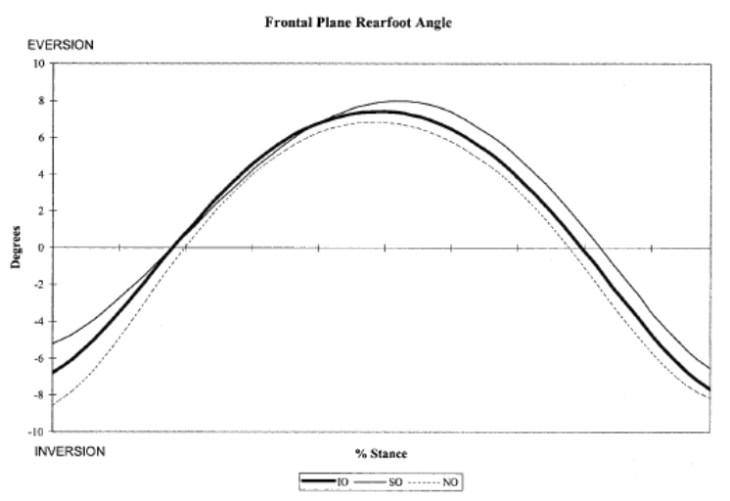
Kinematic Change

Slide 32
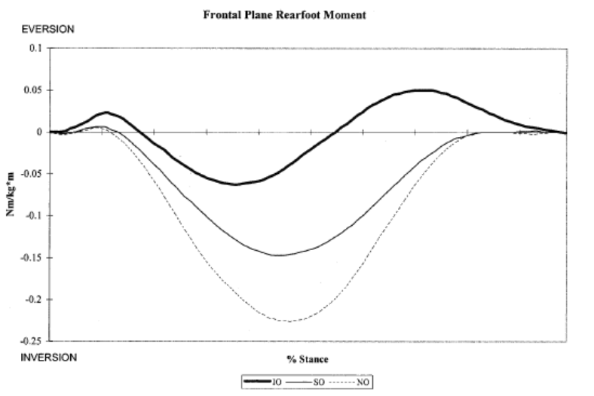
Kinetic Change

Slide 33
Study Conclusions
“There were no differences between conditions in peak rearfoot eversion or rearfoot eversion excursion. Peak rearfoot inversion moment and work were significantly reduced (P = 0.045 and P < 0.001, respectively) in the inverted orthotic condition suggesting a decreased demand on the soft tissue structures that control eversion. Significant differences were seen in tibial rotation (P = 0.043), knee adduction (P = 0.035), and knee abduction moment (P < 0.001) in the inverted orthotic condition, suggesting alterations were made further up the kinetic chain.”

Slide 34
Motion doesn’t hurt, excessive tensile and compressive forces in the osseous and soft tissue structures of the foot and lower limb hurt a lot!
Mechanical aim is to keep osseous and soft-tissues anatomy functioning within elastic limits. This has been termed The Tissue Stress Approach
Notes:
We;ll come to the tissue stress approach in a moment.

Slide 35
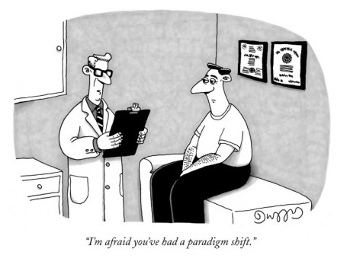
The primary mechanical effects of foot orthoses appear to be kinetic rather than kinematic.
Visible structural changes in the arch height and other osseous segmental realignments may not be required to achieve positive outcomes with foot orthoses.
Orthotic mediated kinetic changes in foot function are invisible, also subject specific, and also difficult to predict!

Slide 36
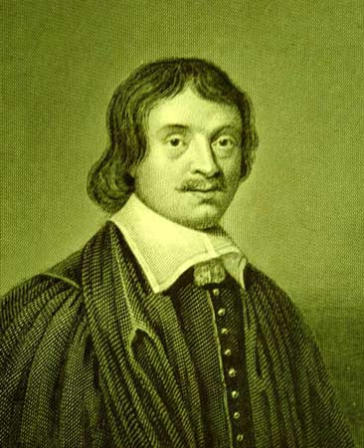
“The only true knowledge of things is the knowledge of their causes.”
Archbishop Leighton(1611 –1684)
Scottish prelate and scholar, and Principal of the University of Edinburgh University, UK from 1653 to 1662.

Slide 37
Pioneers of the Paradigm Shift in the ‘90s
Sagittal Plane Facilitation
Begins with measurement tool, F-Scan®
Created a dynamic kinematic paradigm based on kinetic data to evaluate foot function (dynamics) .
Orthotic prescriptions using small FF wedges, heel lifts, heel cushions, various shapes of first ray cut out and kinetic wedge based on changes to the FxT curves and CoP pathway.
STJ Axis Location and Rotational Equilibrium (SALRE)
Begins with a dynamic kinetic paradigm.
Has no clinical measurement tool to determine the position of the STJ axis during gait. STJ Axis Locator.
Variations in the TP position of the STJ axis determined by static clinical examination.
Dr. Kevin Kirby, DPM
Dr. Howard Dannaberg, DPM

Slide 38
Danaberg Papers & Presentations
DiNapoli DR, Dananberg HJ and Lawton M: Hallux Limitus and Non-specific Bodily Trauma, Reconstructive Surgery of the Foot and Leg, Update ’90, The Podiatry Institute, Tucker, GA (1990).
Dananberg HJ: Gait style as an etiology to chronic postural pain: Part I – functional hallux limitus. JAPMA 83: 433 (1993).
Dananberg HJ: Gait style as an etiology to chronic postural pain: Part II – Postural Compensatory Process. JAPMA 83(11):615-24 (1993).
Dananberg, H J: Lower Extremity Mechanics and Their Effect of Lumbosacral Function, Spine, State of the Art Reviews, Ed. Dorman, T, Henley & Belfus, Philadelphia May 9:2 389-405 (1995).
Dananberg, HJ: Lower back pain as a gait related repetitive motion injury. In: Vleeming A, Mooney V, Dorman T, et al, eds. Movement, stability and lower back pain. Edinburgh: Churchill Livingstone, page 253 (1997).
Dananberg, HJ, Guiliano: “Gait Mechanics and Their Relationship to Lower Back Pain”, in Proceeding of 3rd Interdisciplinary World Congress on Low Back and Pelvic Pain - Vleeming, A, Mooney, V, Tilscher, H, Dorman, T, and Snijders, C, November, (1998) European Conference Organizers, Rotterdam, Holland .
Dananberg, H. J. and M. Guiliano: Chronic Low-Back Pain and Its Response to Custom-Made Foot Orthoses. Journal of American Podiatric Medical Association. 89: pp109-117 (1999).
Dananberg, HJ, Guiliano, M: “Chronic Low-Back Pain And It Response to Custom Foot Orthoses”, Journal of the American Podiatric Medical Association, 89:3 March, pp109-117 (1999).
Dananberg, HJ, “Gait Style and Its Relevance in the Management of Chronic Low-Back Pain”, In Proceedings, 4th Interdisciplinary World Congress of Low Back & Pelvic Pain”, Ed, Vleeming, A, Mooney. V, Gracovetsky, S, Lee, D, et al, November 8-10, pp 225-230 (2001).

Slide 39
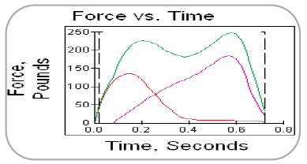
Sagittal Plane Facilitation (1990)
F-Scan system to evaluate:
FxT curves.
CoP pathway.
Dynamics: Kinetic data used to describe sagittal plane motion (or a delay or lack of it – sagittal plane “blockade”) at the ankle and 1st MTPJ (FHL)
“Gait Related Low-Back Pain”.
Notes:
Due to time restrains I have to limit myself to the paradigm shifts in podiatry

Slide 40
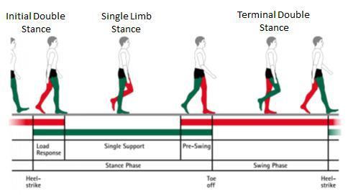
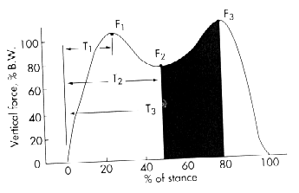
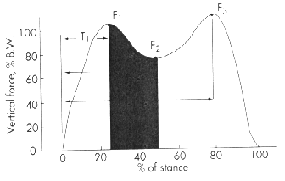
Heel strike to max heel loading Un-weighting of the heel to heel lift
Heel lift to max forefoot loading Max forefoot loading to toe off

Slide 41
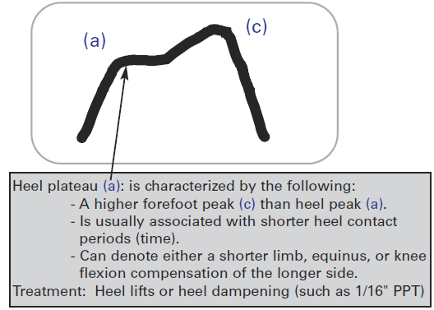
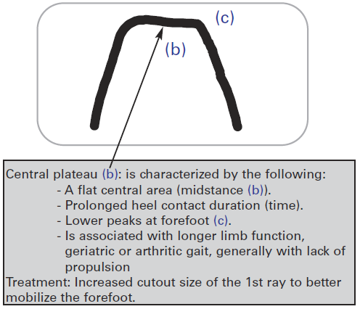
“Foot Behaviors” by FxT curves and orthotic prescription variances
Taken from: Characteristic Patterns in the Gait Curve using F-Scan® by
Howard Dananberg, DPM & Bruce Williams, DPM and published by TekScan, Inc.
http://www.breakthroughpodiatry.com/pdf/forms/Force-vs-Time-Curve.pdf

Slide 42
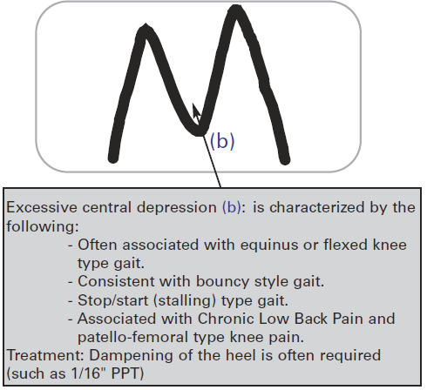
More typical “Foot Behaviors” by FxT curves
Taken from: Characteristic Patterns in the Gait Curve using F-Scan® by
Howard Dananberg, DPM & Bruce Williams, DPM and published by TekScan, Inc.
http://www.breakthroughpodiatry.com/pdf/forms/Force-vs-Time-Curve.pdf

Slide 43
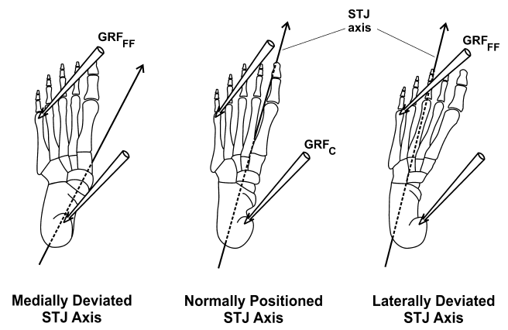
STJ Axis Location and Rotational Equilibrium (SALRE) (1987) Dr. Kevin Kirby
Abnormal STJ rotational forces (i.e., moments, not necessarily motion) are the aetiology of foot pathology.
Variations in the direction of the STJ axis on the TP allow GRF to create pathomechanical forces through MSK system.
Orthoses function by modulating the magnitude and direction of GRF (external moments) to change internal joints moments, and the forces within the joints of the lower-limb and the soft-tissue structures that surround them.
“TISSUE STRESS
MODEL”
McPoil TG, Hunt GC: Evaluation and management of foot and ankle disorders: Present problems and future directions. Journal of Orthopaedic and Sports Physical Therapy, 1995; 21(6): 381-388.
Notes:
Due to time restrains I will limit myself to the paradigm shifts in podiatry

Slide 44
Medial Heel Skive or “Kirby Skive”
Medially deviated STJ axis.
Shifts the Orthotic Reaction Force (ORF) medially on the plantar heel.
May increase the supination moment.
Kirby K.A: The medial heel skive technique. Improving pronation control in foot orthoses, JAPMA Vol. 82, No. 4 p.177-188,1992

Slide 45
Definition of a Foot Orthotic Device - Kirby, 1998
". . . an in-shoe medical device which is designed to alter the magnitudes and temporal patterns of the reaction forces acting on the plantar aspect of the foot in order to allow more normal foot and lower extremity function and to decrease pathologic loading forces on the structural components of the foot and lower extremity during weight-bearing activities. "
Definition is purely kinetic, with no mention of motion control, osseous segmental realignment, nor arch support.
 Does not ascribe to a foot orthosis the ability to function in a proprioceptive manner.
 Does not necessarily have to be prescribed by a physician.
 “ . . . Normal foot and lower extremity function” is difficult to define in both scientific and clinical terms.
Kirby KA, Green DR: Evaluation and Nonoperative Management of Pes Valgus, pp. 295–327. in DeValentine S.(ed.), Foot and Ankle Disorders in Children. Churchill-Livingstone,New York, 1992.
Kirby KA: Foot and Lower Extremity Biomechanics II: Precision Intricast Newsletters, 1997–2002. Precision Intricast, Inc., Payson, AZ, 2002.
Notes:
In The Manufacture and Use of the Functional Foot Orthosis. Karger, Basel, Switzerland, 1991, I offered the following definition of a functional foot orthosis: "the functional orthosis is an orthopaedic device which is designed to promote structural integrity of the joints of the foot and lower limb, by resisting ground reaction forces that cause abnormal skeletal motion to occur during the stance phase of gait" (Anthony, Raymond J.:). You an see this is totally kinematic definition.
Issues with two words in this definition “Medical” and ‘Normal”
I would tweak Kirby’s definition as follows:
“An in-shoe device designed to alter the magnitudes, direction, and temporal patterns of the ground reaction force acting on the plantar surface of the foot in order to promote more efficient foot and lower extremity function and to decrease pathological stress acting upon the soft-tissue and osseous anatomy of the foot and lower-extremity.”

Slide 46
Improved Definition?
“A foot orthotic device is an in-shoe device designed to alter the magnitudes, directions, and temporal patterns of ground reaction force acting on the plantar aspect of the foot in order to encourage improved foot and lower-extremity function, by decreasing pathological loading forces on the osseous and soft-tissue structures of the foot and lower-limb during weight-bearing activities. "

Slide 47
“Foot orthoses do not work by supporting the arch, controlling motion, or by postural realignment; they work by modulating the magnitudes and direction of ground reaction forces (GRF) acting on the plantar surface of the foot, which in turn alters the internal moments around the joints, which in turn modulates muscle function, which in turn reduces excessive tensile and compression stresses through the osseous and soft-tissue structures of the foot and lower-limb.”
- Ray Anthony, FCPodS, DPodM (7 February, 2011).

Slide 48
Tissue Stress Paradigm approach to treatment
“By wedging the inner border of the heel the tibials are relieved. By wedging the outer side of the sole, the strain on the peroneus longus is removed. Clinical practice shows that the degree of wedging must be determined for each individual case.”
-- William Sayle-Creer (1904-1984)
Contralateral Wedging of shoes without the need for an arch support, 1937.

Slide 49
Tissue Stress Approach
Identify painful anatomical structures.
Determine structural and/or functional variables that may be the source of excessive tensile and/or compression forces on the injured structure(s).
Design an orthosis to reduce the magnitude of pathological forces on injured structure(s) that will cause no other pathology or symptoms by transference of force to other “at-risk” structures.
Fuller EA: Center of pressure and its theoretical relationship to foot pathology JAPMA, 89 (6):278-291, 1999.
Fuller EA: Reinventing biomechanics. Podiatry Today, 13:(3), December 2000.
Kirby KA: Tissue stress approach to mechanical foot therapy. Precision Intricast Newsletter, February 2002.
Kirby KA: The biomechanics of tissue stress. Precision Intricast Newsletter, Payson, Arizona, March 2002.
Kirby KA: Using the tissue stress approach in clinical practice. Precision Intricast Newsletter, April 2002.
Fuller EA, Kirby KA: Subtalar joint equilibrium and tissue stress approach to biomechanical therapy of the foot and lower extremity. In Albert SF, Curran SA (eds): Biomechanics of the Lower Extremity, Bipedmed, Denver, 2013, pp. 205-264.

Slide 50
CoP Related to Foot Pathology & Orthotic Prescriptions
Eric Fuller, DPM
Fuller EA: Centre of Pressure and it’s theoretical relationship to foot pathology, J Am Podiatr Med Assoc. 1999 June;89(6):278-91.
“When the CoP is medial to the STJ axis it will produce a supination moment, when it is positioned laterally it will produce a pronation moment.”
?

Slide 51
CoP relative to STJ Axis
GRF is a vector composed of three force components:
Vertical force
Anterior-posterior shear
Medial-lateral shear
The net GRF vector has:
Point of application (CoP)
Line of action
Magnitude
The position and magnitude of the vector (not just the point of application) relative to a joint axis will determine the moment acting across the joint.

Slide 52
CoP relative to STJ Axis
Even if we could map the trajectory of the CoP relative to the STJ axis during gait we could not establish if the vector line of action falls medial or lateral to the axis.
If an orthosis produces a medial shift in the CoP at the plantar heel, all we can say is that it has the potential to increase in the supination moment around the STJ axis.
Spooner SK, Smith DK, Kirby KA: In-shoe pressure measurement and foot orthosis research: a giant leap forward or a step too far? J Am Podiatr med Assoc. 2010 Nov-Dec;100(6):518-29

Slide 53
Kinetic Approach to Rx Writing
Forget motion “control” and arch support.
Kinetically, an orthosis can only achieve three mechanical effects:
Alter the magnitude of GRF
Alter the direction of the vector of GRF
Alter the temporal pattern of GRFs
An associated joint kinematic response may or may not occur.
Only three orthotic design options matter:
The surface geometry of the orthosis.
The load deformation characteristics (stiffness) of the orthosis.
The frictional properties at the orthosis/ foot interface.
Notes:
Every single modification or design feature that exists and can be incorporated into an orthosis will change one or more of A, B, C and in turn will more than likely alter kinetics at the foot-orthosis interface via one (or more) of 1, 2, 3. It is making these decisions in the context of a real person with a real pathology that should be the goal of anyone implementing orthoses therapy as part of a rehabilitation strategy.

Slide 54
Kinematic response at the foot-orthosis interface
“Under loading, all areas of the foot-orthosis interface will undergo displacement to a greater or lesser degree. Hooke's Law - "reaction" force = -k X , where k=stiffness and X = displacement. Since displacement is a kinematic variable, there is always a kinematic change when wearing foot orthosis at the foot-orthosis interface, we've just been looking in the wrong place."
-- Dr. Simon Spooner
Personal Communication, 10.10.13

Slide 55
Preferred Movement Pathway Model
Dr. Nigg again: "Experimental evidence suggests that the concept of "aligning the skeleton" with shoes, inserts, and orthotics should be reconsidered. They produce only small, not systematic, and subject-specific changes of foot and leg movement. A new paradigm for movement control for the lower extremities proposes that forces acting on the foot during the stance phase act as an input signal producing a muscle reaction. The cost function used in this adaptation process is to maintain a preferred joint movement path for a given movement task.“
Benno Nigg, et al: Effect of shoe insert construction on foot and leg
movement. Sci Sports Med Exerc. 1998 Apr;30(4):550-5

Slide 56
Dedieu P, Drigeard C, Gjini L, Dal Maso, F, Zanone PG: Effects of foot orthoses on the temporal pattern of muscular activity during walking. Clin Biomech (Bristol, Avon) 2013 Aug;28(7):820-4.
12 adults with static everted heel positions > 5 degrees.
With and without custom-made foot orthoses.
Motion analysis and surface EMG used to collect kinematic and temporal activity of tibialis anterior, soleus, medial and lateral components of gastrocnemius and peroneus longus
Results: Activity of all muscles shorter. Action of soleus and gastrocnemius delayed. Start time and duration of activity are modified with orthoses.

Slide 57
Other papers
Foot orthoses alter the EMG activity of biceps femoris and tibialis anterior during running and walking.
Tomaro J, Burdett RG: The effects of foot orthotics on the EMG activity of selected leg muscles during gait. J Ortho Sp Phys Ther, 18:532–536, 1993.
Nawoczenski DA, Ludewig PM: Electromyographic effects of foot orthotics on selected lower extremity muscles during running. Arch Phys Med Rehab, 80:540–544, 1999.
Correlation between orthotic comfort and EMG activity.
Mundermann A, Nigg BM, Humble RN, Stefanyshyn DJ: Orthotic comfort is related to kinematics, kinetics, and EMG in recreational runners. Med Sci Sports Exercise, 35:1710–1719, 2003.
Changes in orthotic design causes changes in EMG activity of many muscles during running.
Mundermann A, Wakeling JM, Nigg BM et al.: Foot orthoses affect frequency components of muscle activity in the lower extremity. Gait Posture, 23:295–302,2006.

Slide 58
Kinetic approach to Achilles tendinopathy/calf muscle myositis
Using basic free-body diagrammes

Slide 59
∑F a,b = - ∑F b,a
Newton's third law of motion (Motion is Newton's word for Momentum): "To every action there is always an equal and opposite reaction," or the forces of two bodies on each other are always equal and are directed in opposite directions.

Slide 60
Moment (Torque)
The Moment (Torque) of a force is a measure of its tendency to cause a body to rotate about a specific point or axis. In order for a moment to develop, the force must act upon the body in such a manner that the body would begin to twist. A moment has a direction, e.g., clockwise or counter-clockwise, or inversion of eversion, or pronation and supination and is created when a force does not have an equal and opposite force directly along its line of action. The simple equation for Moment is: M(T)=Fd
F = Newtons (I.0 lb is 4.448 N)
d = meters
Unit of measurement = Nm

Slide 61
In the biomechanics of joints, a single moment may:
Accelerate joint motion in the same direction of the moment.
Decelerate joint motion in the direction opposite the applied moment.
Stabilize a joint by counterbalancing a moment being applied across the joint in the opposite direction.

Slide 62
Vertical GRF creates External Joint Moments
If d = 18.0cm and F = 120 Newtons, Moment = 2160Ncm in a dorsiflexion direction.
If the foot is not dorsiflexing, there must be 2160Ncm of plantar flexion moment acting around the ankle joint axis = Zero Moment or Rotational Equilibrium.
18.0 cm
F
120N
Notes:
I’ll use Newton/cm instead of Newton/meter.

Slide 63
If the distance on the other side of the axis (d²)is d¹/3 (6.0cm), we know the force acting on the heel must be 3x the force acting on the forefoot or 360N to create rotational equilibrium, i.e., the foot is not moving.
d²
d¹
Fx1
120Ncm
Fx3
360Ncm
This is Newton's third law of motion (Motion is Newton's word for Momentum): "To every action there is always an equal and opposite reaction," The forces are always equal and are in opposite directions.

Slide 64
Internal Moments
If we stand the same foot on a pressure mat and discover the pressures beneath the forefoot and heel are distributed 50:50? If the foot is not dorsiflexing (rotational equilibrium), we know there must be a further plantarflexion moment of 1440Ncm acting on the foot from another origin.
6.0 cm
18.0 cm
120 N
120 N
Fx1
6 x120
= 720Ncm plantarflexionmoment
18 x120
= 2160Ncm dorsiflexion moment
Fx3

Slide 65
1440Ncm
From our understanding of functional anatomy we know the superficial posterior muscle group (calf muscles-Achilles tendon complex) provides the major internal plantarflexion moment to maintain postural stability in static stance.
6.0 cm
18.0 cm
120 N
120 N
Fx1
18 x120
= 2160Ncm dorsiflexion moment
6 x120
= 720Ncm plantarflexionmoment

Slide 66
Orthotic modifications
What modulations in the magnitude and direction of GRF can we make to reduce tension in the calf muscle/Achilles tendon complex?
An increase in the magnitude of external plantarflexion moments and/or a reduction in the magnitude of external dorsiflexion moments means the Achilles tendon does not have to generate such a high magnitude of internal plantarflexion force to maintain rotational equilibrium.
Reduce the magnitude of GRF beneath the forefoot.
Increase the magnitude of GRF beneath the heel.

Slide 67
An orthosis for Achilles tendonitis might have a soft forefoot extension or a gel pad beneath the forefoot, and a hard heelcup to modulate the magnitude and temporal pattern of GRF beneath the sole of the foot.
Heel lift: Is it the lift or the increase in the magnitude of force beneath the heel that provides the beneficial therapeutic effect?
The foot has not changed position.
The foot has not been “supported.”
The foot has not be “stabilized.”
Foot posture has not changed.

Slide 68
Understanding how an increase in forefoot pressure creates an increase dorsiflexion moment around the ankle, and the necessity for an increase in the plantarflexion moment from the calf muscles to effect rotational “control” during the running gait cycle gives us a clue as to why runners changing from a midstance or heel strike to a forefoot strike running style places more tensile strain through the Achilles tendon, which may make them prone to Achilles tendinopathy or calf muscle strain.

Slide 69
The latest running shoe for the forefoot striker!
By Kobi Levy, Israeli fashion shoe designer

Slide 70
Pronation and supination moments
Achilles tendinopathy is a sagittal plane example, but the concept of GRF Modulation may be applied to modulate frontal plane moments to relieve symptoms.

Slide 71
Basic Kinetic Rx’s
Forefoot
1. Hard Medial /Soft Lateral:
Shift CoP medially causing an increase in the dorsiflexion and inversion moment around the MTJ and First-Ray. Most common Rx to limit hallux dorsiflexion with anatomical hallux limitus/rigidus.
2. Soft Medial /Hard Lateral:
Shift CoP laterally causing an increase in the pronation moment around the MTJ. Tx for peroneal tendinopathy, chronic ankle sprains, ITB syndrome at the knee, etc.
Rearfoot
1. Hard Medial /Soft Lateral:
Shift CoP medially causing an increase in the supination moment around the rearfoot. Tx for PT tendinitis, medial ankle joint capsolitis, Deltoid ligament strain, etc.
2. Soft Medial /Hard Lateral:
Shift CoP laterally causing an increase in the pronation moment around the rearfoot. Tx for peroneal tendinopathy, chronic ankle sparins, ITB syndrome at the knee, etc.

Slide 72
Basic Kinetic Rx’s
Forefoot to Rearfoot
1. Hard Heel /Soft Forefoot
Reduce magnitude of GRF beneath forefoot and increase GRF beneath the heel. Decreases the ankle dorsiflexion moment and increases the ankle plantarflexion moment. Tx Achilles tendinopathy, calf muscle strain.
2. Soft Heel/Hard Forefoot
Increase magnitude of GRF beneath forefoot and decrease GRF beneath the heel. Increases the ankle dorsiflexion moment and decreases the ankle plantarflexion moment. Tx Extensor and Tibialis Anterior tendinopathy.

Slide 73
Overuse injuries may occur when healthy tissue is stressed in an abnormal way; when unhealthy tissue is stressed in a normal way, or when unhealthy tissue is stressed in an abnormal way.
Each tissue type has a zone of optimal stress – ZOOS.

Slide 74
Conclusions
Abnormal tensile and compressive forces cause tissue damage.
Excessive forces may occur WITHOUT MOTION.
Foot orthoses produce small, unpredictable and subjective kinematic changes.
Research suggest that orthotic devices have a greater kinetic rather than kinematic effect.
Kinematic to kinetic paradigm shift is taking place; many would say has already taken place.
Think force instead of motion.
Aim of foot orthotic device is to return tissues to ZOOS.
Discover and work the Tissue Stress Paradigm and use orthotic Rxs to reduce stress in the injured tissues.
It doesn’t matter what the foot looks like on the orthosis!

Slide 75
From: The myths of foot orthoses… A guest article by Ian Griffiths, The Sport Physio @ Wordpress.com
“The skilled clinician is capable of identifying the dysfunctional tissue (and the severity of injury to it); they understand the biomechanical function of the tissue during given activities; and they comprehend the manner in which each of the 3 orthoses design variables interact with one another, and ultimately their kinetic influence on the foot.”

Slide 76
Thank you

